Slide 1
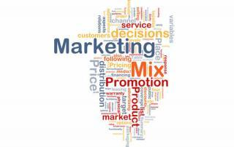
PRODUCT MIX
Dr. J. SUNDARARAJ
Associate Professor of Commerce,
Annamalai University

Slide 2
PRODUCT
Product means the goods-and-services combination the company offers to the target market. - Kotler and Armstrong (2010).
Product is not only tangible, but technically a Product is anything that can be offered to a market to satisfy a want or need, including physical goods, services, experiences, events, persons, places, properties, organisations, information and idea. - Kotler and Keller (2016)
“A Product is a set of tangible and intangible attributes, including packaging, colour, price, manufacturer’s prestige, retailer’s prestige and manufacturer’s and retailer’s service which the buyer may accept as offering want satisfaction”
- William J Stanton

Slide 3
Features of Product
Goods and Product
  Anything that satisfy human wants and needs
  Tangible or intangible
  Include service – tourism services, health care services, educational service etc.
Bundle of Utilities/Benefits
  Tablet relieves pain or discomfort , movie may give entertainment
Associated Attributes
  Brand, package, label, warranty
Exchange value
  Exchange for money – exchange value
Consumers Satisfaction
  Must satisfy a need or want
  satisfaction is ultimate metric of a product performance

Slide 4
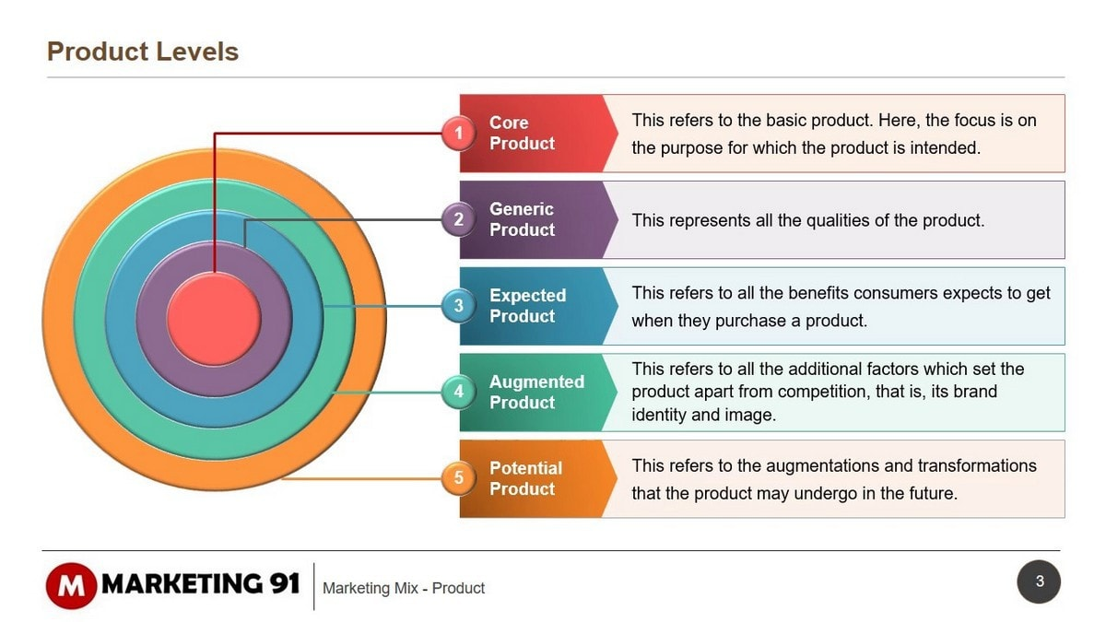
Product Levels – The Customer-Level Hierarch
While planning market offering, the marketer needs to address Five Product Levels.
Each level adds more Customer Value, and together the five constitute a Customer-value Hierarchy.

Slide 5
Product Levels – The Customer-Level Hierarch
The fundamental level is the CORE BENEFIT: The service or benefit the customer is really buying.
    A hotel guest is buying rest and sleep.
At the second level, the marketer must turn the core benefit into BASIC/Generic/Actual PRODUCT .
  A hotel includes a bed, bathroom, towels, desk, dresser and closet.
At the third level, the marketer prepares an EXPECTED PRODUCT, a set of attributes and conditions buyers normally expect when they purchases this product.
  Hotel guests minimally expect a clean bed, fresh towels, working lamps and a relative degree of quiet.
AT the fourth level, the marketer prepares an Augmented Product that exceeds customer expectations.
  Free breakfast, good ambience with music etc
At the Fifth level stand the Potential Product, which encompasses all the possible augmentations and transformations the product or offering might undergo in the future.
  Wi-fi facilities

Slide 6
Product Attributes
A number of attributes will be added in order to differentiate product from its competitors.
The attributes will include a variety of additional features, quality levels, design, branding, customer service etc.
The attributes are developed to meet the needs of the target market and provide a competitive advantage for the product.
The product attribute decisions:-
  Product Quality - refers to the ability of the product item to perform its intended functions - durability, reliability, precision, performance and ease of operation.
    The selection of quality level depends on the Target market and Positioning
  Product Features – in addition to core benefit product, the firm must offer features that a consumer would expect. - important product differentiation
  Product Design –indicates its usefulness as well as makes it attractive.
    Products can be distinguished with its unique style/design which helps to create a distinct “Personality” for the Product.
    A distinctive design is difficult to create, relatively rare and usually expensive.
    mass market goods – standard styles

Slide 7
Product Polices
General rules set up by the management in the product decisions
Good product policies are the basis on which the right products are produced and marked successfully.
Determine the success or failure of the firm
“Product Policy is concerned with defining the type, volume and timing of the product a company offer for sale”
The product policy is the objectives and guidelines, which determine the nature of the product or services, to be marketed.
  Product Planning and Development
  Product Line
  Product Mix
  Product Branding (Identification)
  Product Style
  Product Positioning
  Product Packaging

Slide 8
Product Mix
Product mix (Product Assortment) is the set of all products and items that a particular seller offers for sale to buyers
- Philip Kotler
Product mix (Product Assortment) – total number of product lines a company offers to its customers.
Dimensions of Product Mix
  Product Mix Width – Number of Product Lines
    refers to how many different product lines the company caries
  Product Mix Length – Total Products or items
    refers to the total number of items in the mix
  Product Mix Depth – Product Variations – size , flavour colours
    refers to how many variants are offered of each product in the line
  Product consistency – How closely related product lines
    refers to how closely related the various product lines are in end use,

Slide 9
Product Mix
Product mix (Product Assortment) is the set of all products and items that a particular seller offers for sale to buyers
- Philip Kotler
Product mix (Product Assortment) – total number of product lines a company offers to its customers.
Dimensions of Product Mix
  Product Mix Width – Number of Product Lines
    refers to how many different product lines the company caries
  Product Mix Length – Total Products or items
    refers to the total number of items in the mix
  Product Mix Depth – Product Variations – size , flavour colours
    refers to how many variants are offered of each product in the line
  Product consistency – How closely related product lines
    refers to how closely related the various product lines are in end use,

Slide 10
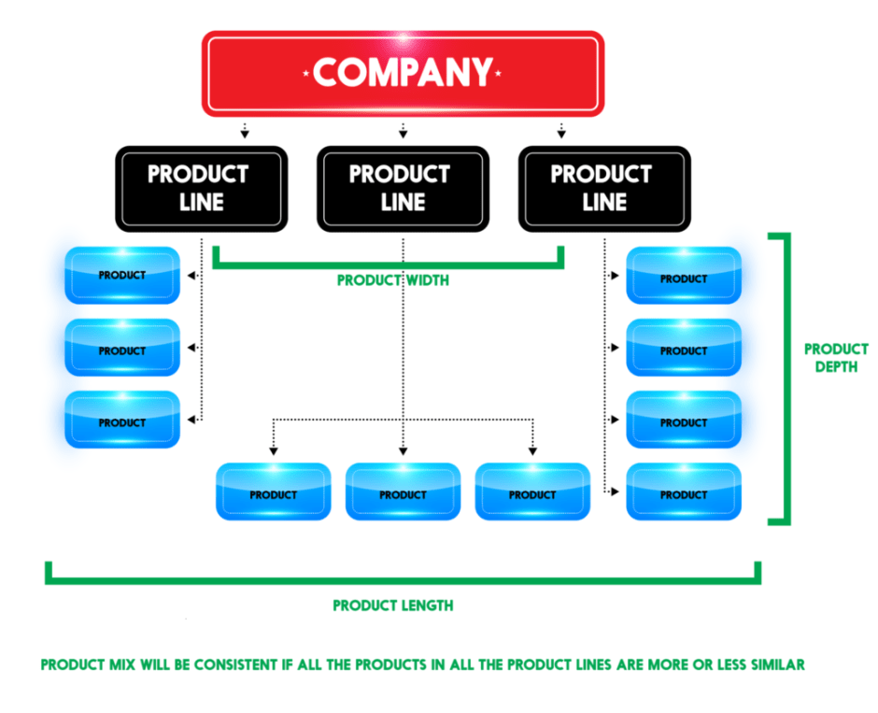

Slide 11
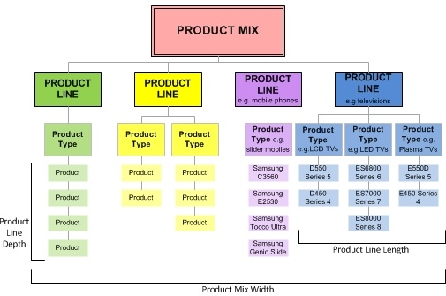

Slide 13
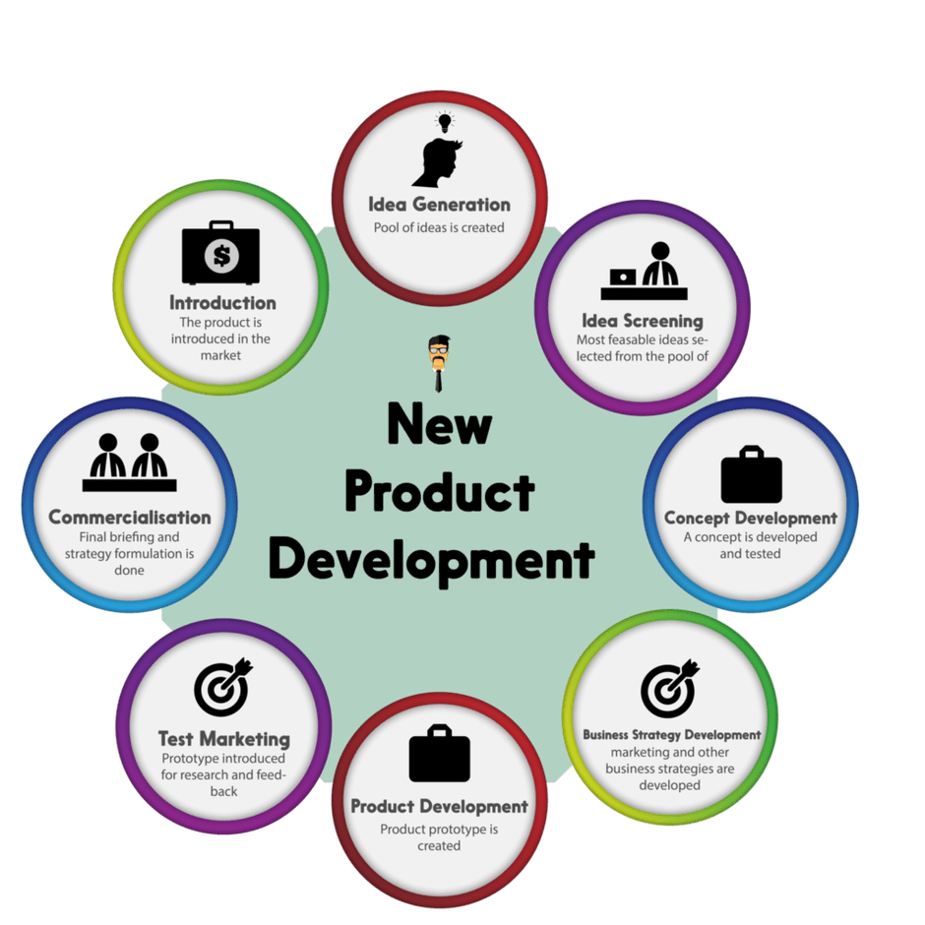

Slide 14
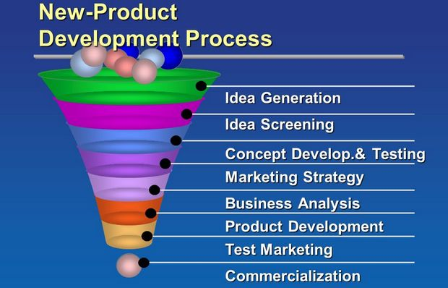

Slide 15
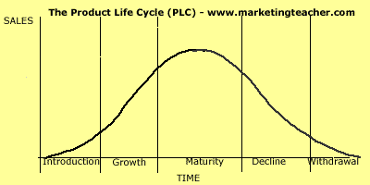
Product Life Cycle

Slide 16
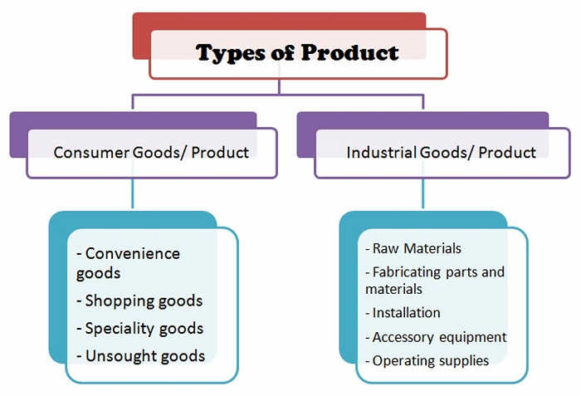
Classification of Products
Two types of products are distinguished based on who will use them and how they will be used.
Consumer Products are intended for use by household consumes for non-business purposes.
Business Products are intended for resale, for use in producing other products, or for providing services in an organisation.

Slide 17
Classification of Consumer Products
  Convenience Goods: A product that the consumer knows enough about before going out to buy it and then actually buys it with a minimum of effort is termed as Convenience good.
  - William J. Stanton
  Shopping Goods: A tangible product for which consumers want to compare quality, price, and perhaps style in several stores before making a purchase is considered a Shopping Good.
  -William J. Stanton
  Specialty Goods: A tangible product for which consumers have a strong brand preference and are willing to expend substantial time and effort in locating the desired brand is called a Speciality Good.
  - William J. Stanton
  Unsought Goods: is a new product that the consumer is not yet aware of or a product that the consumer is aware of but does not want right now.
  - William J. Stanton

Slide 18
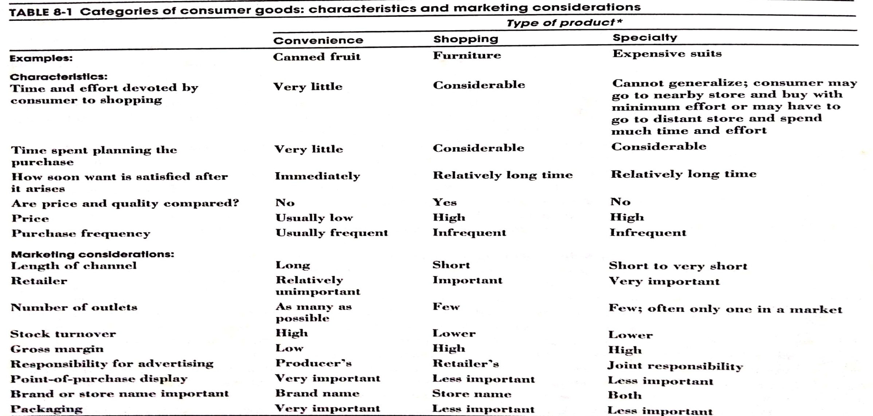
Classification of Products

Slide 19
Classification of Business Products
Raw Materials: Business goods that become part of another tangible product prior to being processed in any way.
  Goods found in their natural state, such as minerals, products of the forests and the seas
Fabricating Materials and Parts: Business goods that become part of the finished product after having been processed to some extent fit into the category of fabricating materials and parts.
  Fabricating Materials undergo further processing – pig iron going into steel, yarn being woven into cloth & flour becoming part of bread
  Fabricating Parts - are assembled with no further change in form; semiconductors chips in computers; zippers in clothing
Installations: Manufactured products that are an organisation’s major, expensive and long-lived equipment.
Accessory Equipment: have substantial value and are used in an organisation’s operations .
Operating Supplies: Business goods that are characterised by low Rupee value per unit and a short life and that aid in organisation’s operation’s operations without becoming part of the finished product.

Slide 20
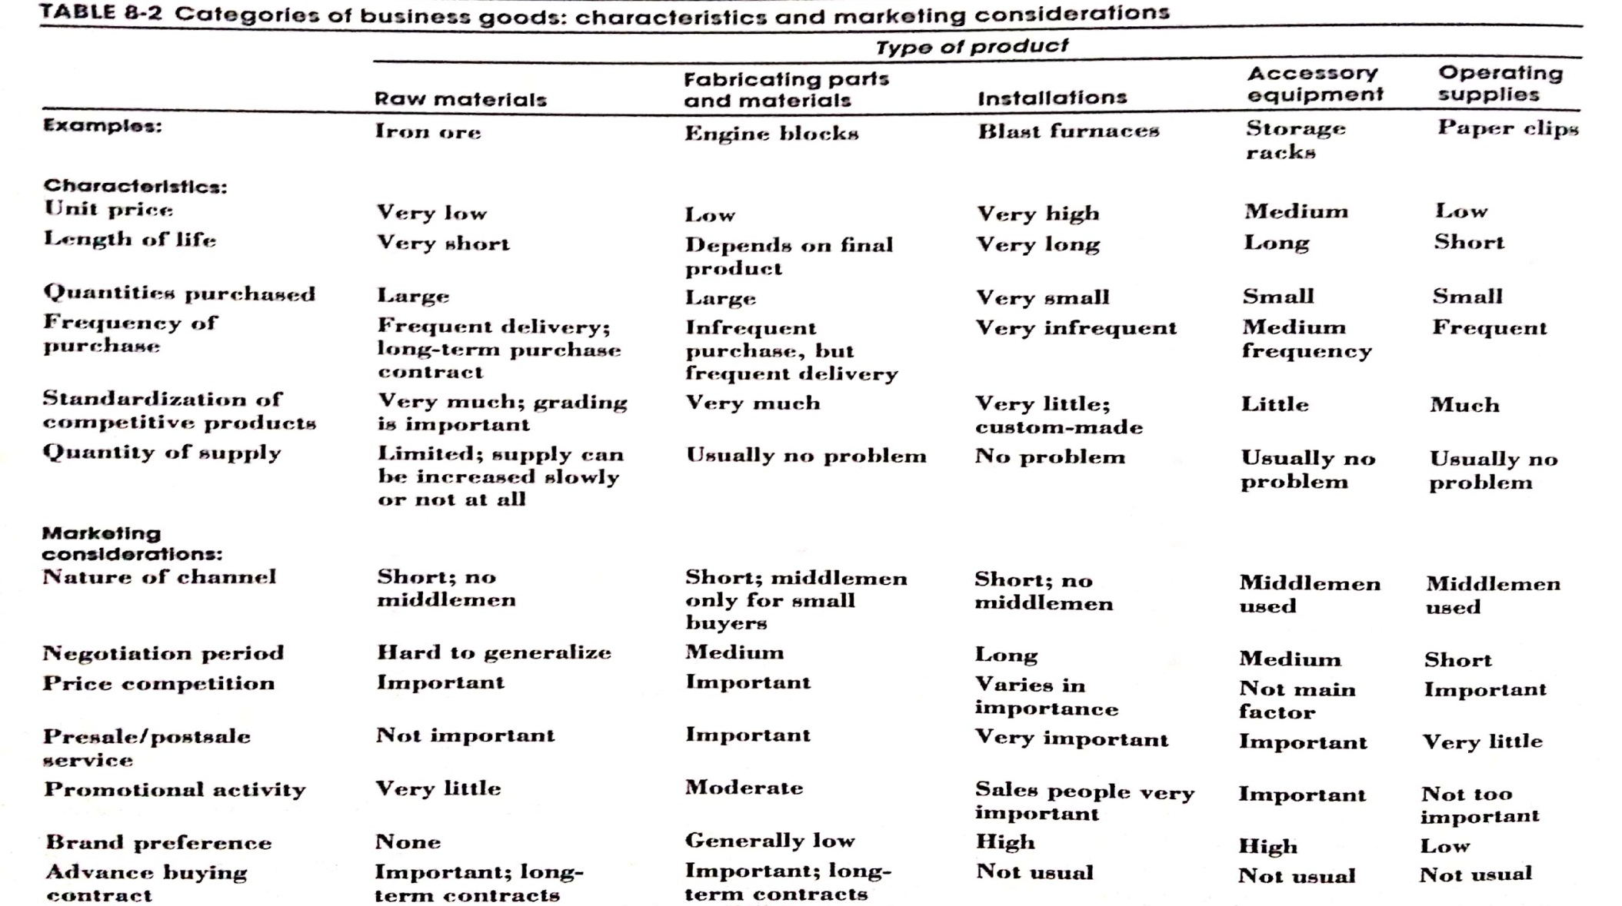
Classification of Business Products

